Slide 1
Chapter 9
Regression Testing

Slide 2
Overview
Regression Testing
When to do regression testing
Regression Testing Cycle
Advantages and Disadvantages of Regression Testing
Challenges of Regression Testing
Types of regression testing
Types of regression testing process
Process of Conducting Regression Testing

Slide 3
Regression Testing
Def: Regression testing is a test to make sure that the product works fine with new functionality, bug fixes, or any change in the existing feature.
Regression testing is a black box testing techniques.
Regression testing can be performed on a new build when there is a significant change in the original functionality. It ensures that the code still works even when the changes are occurring. Regression means Re-test those parts of the application, which are unchanged.

Slide 4
When to do Regression Testing
If new functionality added to the application
If there is a Change Requirement.
If any defect fixed
If there is a performance issue fix
If there is an environment change

Slide 5
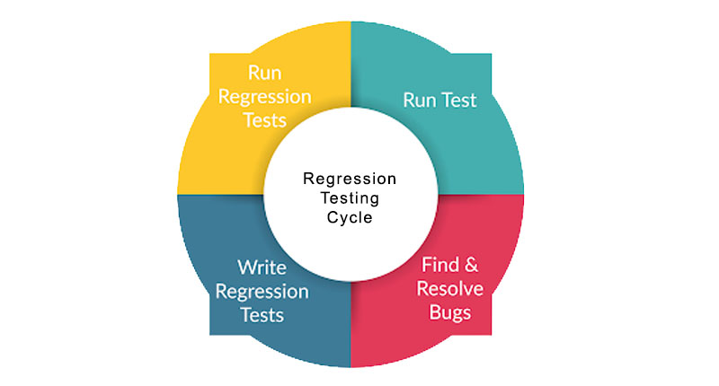
Regression Testing Cycle

Slide 6
Advantages of Regression Testing
Disadvantages of Regression Testing
Increases the chance of detecting bugs at early stages
Helps identifying unwanted side effects and errors due modification
Ensures no errors occurs again by retesting (selective or whole)
Without automation, regression testing can be time-consuming.
Need to perform for every small change of code.
A highly repetitive process may affect the agile sprint.
Requires you to create complex test cases

Slide 7
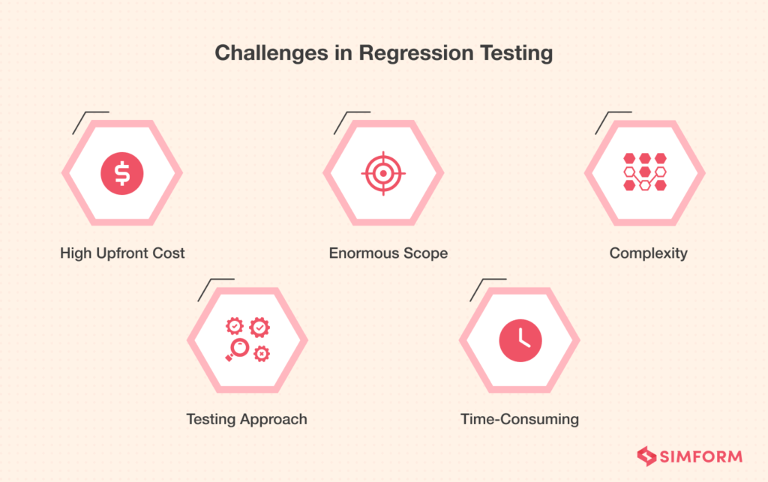

Slide 8
Challenges in Regression Testing
High Upfront Cost: Regression testing is very time-consuming if done manually. That’s why automation takes preference, and for that to happen, you require high-end infrastructure and tools, which can be highly expensive.
Testing Approach: Selecting a proper testing approach is crucial to success as far as regression testing goes. You may have skilled resources and tools at your disposal, but you will struggle if you don’t have a proper plan for when and how to approach or conduct regression testing.
Enormous Scope and Coverage: The success of regression testing depends on the type of test cases suite you have built. Between every build and release, you need to update the regression suite created. Now, remembering each change would be hard for testers, and regression testing is impossible without that. That’s the only way to cover all the elements. Thus, the enormous scope is a massive challenge.
Complexity: As you move from the first build to the second and then so on, the number of test cases increases. That’s why the regression test suite will become more and more complex. You will have to test the new cases as well as the old cases all the time.

Slide 9
Types of Regression Testing
The different types of Regression Testing are as follows:
Unit Regression Testing [URT]
Regional Regression Testing[RRT]
Full or Complete Regression Testing [FRT]

Slide 10
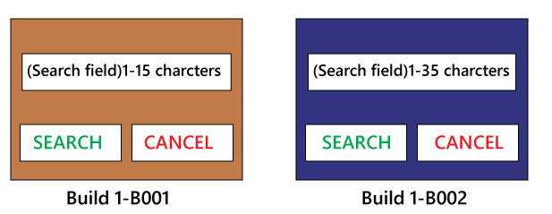
Unit Regression Testing
In this, we are going to test only the changed unit, not the impact area, because it may affect the components of the same module.
Example: Client does some modification in the requirement and also requests that the Search button can accept the 1-35 characters instead of 1-15 characters. The test engineer will test only the Search button to verify that it takes 1-35 characters.

Slide 11
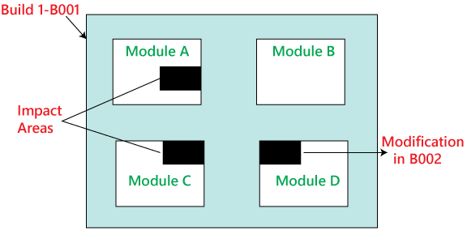
Regional Regression testing [RRT]
To test the modification along with the impact area or regions, are called the Regional Regression testing. Here, we are testing the impact area because if there are dependable modules, it will affect the other modules also.
Example: The bug fixing in Module D has impacted some features in Module A and C.
Hence, the test engineer first tests the Module D where the bug has been fixed. Then checks the impact areas in Module A and Module C.

Slide 12
Disadvantages of IRT and RRT :
Following are some of the drawbacks of using Unit and Regional regression testing:
We may miss some impact area.
It is possible that we may identify the wrong impact area.

Slide 13
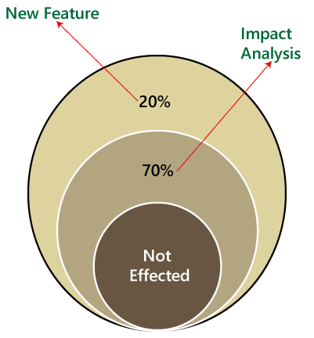
Full Regression testing [FRT]
Testing the modified features and all the remaining (old) features is called the Full Regression testing.

Slide 14
Full Regression testing [FRT]
When the application is given for the testing, the test engineer will test the first 10-14 cycle, and will do the RRT. Then for the 15th cycle, we do FRT. And again, for the next 10-15 cycle, we do Regional regression testing, and for the 31th cycle, we do the full regression testing, and we will continue like this.
The drawback of doing regression testing repeatedly:
Productivity will decrease.
It is a difficult job to do.
There is no consistency in test execution.
Test execution time is also increased.

Slide 15
Types of Regression Testing Process
The regression testing process can be performed across the
Builds and
The Releases.
The main difference between Build and Release in Software Testing is that Build is a version of the software the development team hands over to the testing team for testing purpose while Release is the software the testing team hands over to the customer.

Slide 16
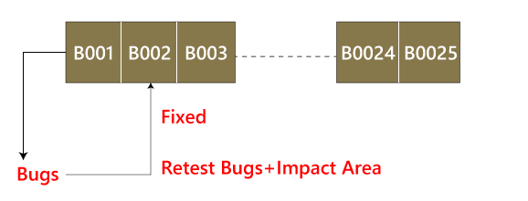
Regression testing across the builds
Whenever the bug fixed, we retest the Bug, and if there is any dependent module, we go for a Regression Testing.

Slide 17
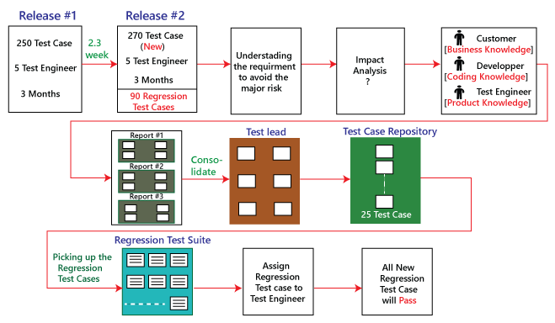
Regression Test across Releases

Slide 18
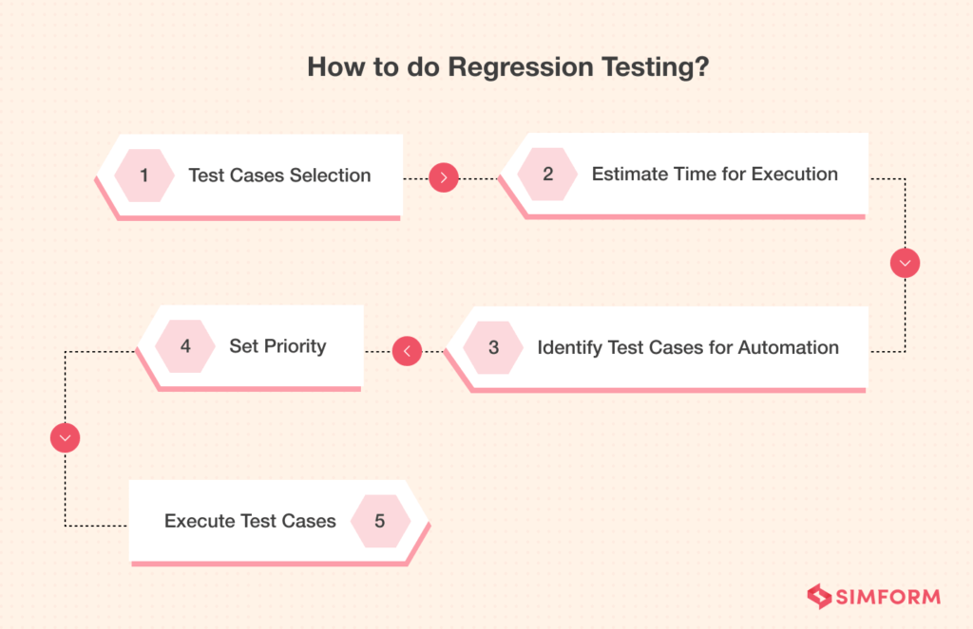

Slide 19
Process of Conducting Regression Testing
Step 1: Regression Test Selection: Selection of test cases will depend on the module where there is a change in the source code. Then divide these test cases into (i) Reusable Test Cases and (ii) Obsolete Test Cases. Only reusable ones will be used for future regression cycles. Here are the tricks to identify the reusable test cases:
highly error-prone
verifies the functionality of application
contain features that are visible to users
have a recent change in the source code
related to integration
related to boundary-value
Step 2: Determine the Time for Executing Test Cases
To determine the time, factors that affect the execution time are considered. These are test data creation, regression test planning by the QA team, review of all test cases, etc

Slide 20
Process of Conducting Regression Testing
Step 3: Identify the Test Cases that can be Automated: QA team can decide the test cases that they can automate. Automated test cases are faster than manual testing and allows to re-use the same script repeatedly.
Step 4: Test Cases Prioritization After gathering all the test cases and prioritize, those should be prioritized, i.e., high, medium, and low. The priority will depend on the product’s functionality and user involvement. Below is the waterfall structure of priorities:
Priority 0: The most critical test cases include all the core functionalities.
Priority 1: Essential features, but not a part of core functionality.
Priority 2: Test cases related to technical debt.
Examples of technical debt are Cut and pasted or duplicate code, Untested code. Unreadable code, Out of date documentation, Dead code (code that never runs), Spaghetti architecture.

Slide 21
Process of Conducting Regression Testing
Step 5: Executing Test Cases: Finally all the test cases are executed one by one to see whether the product is working as it should or not. Both manual and automated testing can be done based on the requirement. For automated regression testing, utilizing tools like Selenium, QTP, Watir, etc., allows you to execute the test cases faster.

